Slide 1
Arduino WeMos Board Development environment Setup

Slide 2
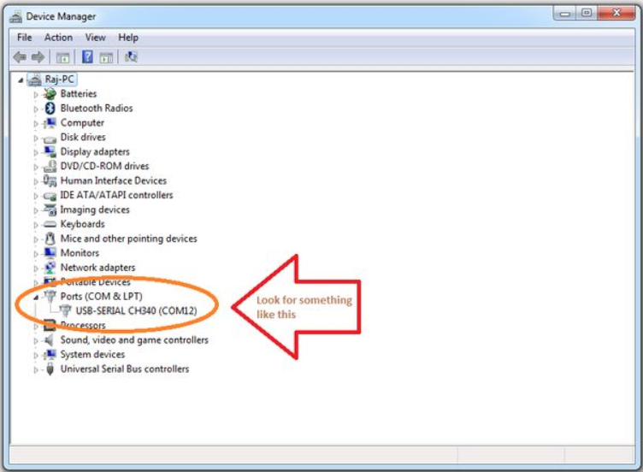
Arduino WeMos Board Development environment Setup
STEP 1
Arduino connects your laptop to Arduino Wemos.
Check in Device Manager. Please refer to the picture below.

Slide 3
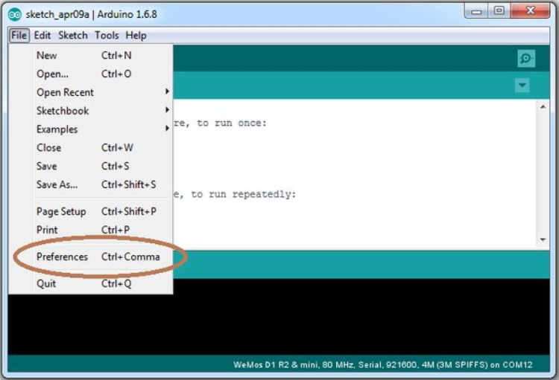
Arduino WeMos Board Development environment Setup
STEP 2
Click "File> Preferences".

Slide 4
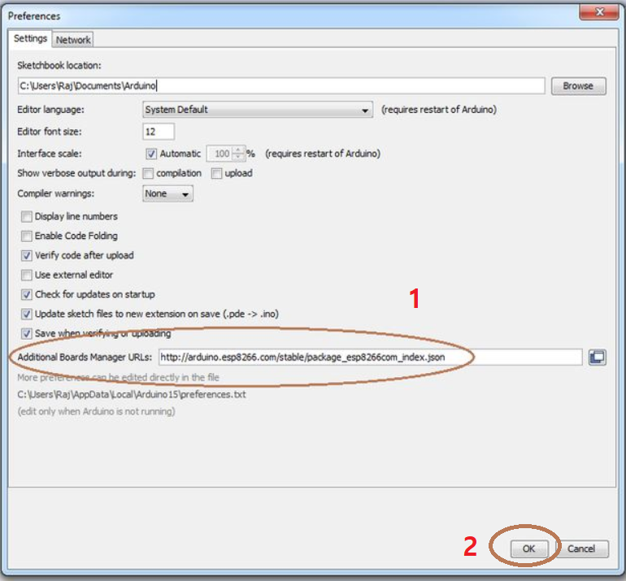
Arduino WeMos Board Development environment Setup
STEP 3
Copy the following URL address to the circle 1. and OK
“http://arduino.esp8266.com/stable/package_esp8266com_index.json”

Slide 5
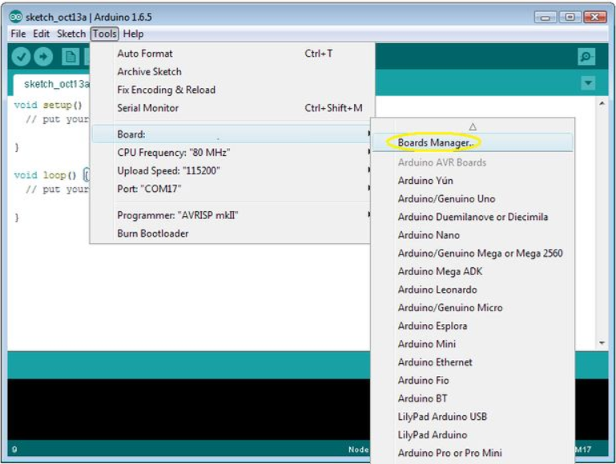
Arduino WeMos Board Development environment Setup
STEP 4
Select "Tools> Board> Boards Manager".

Slide 6
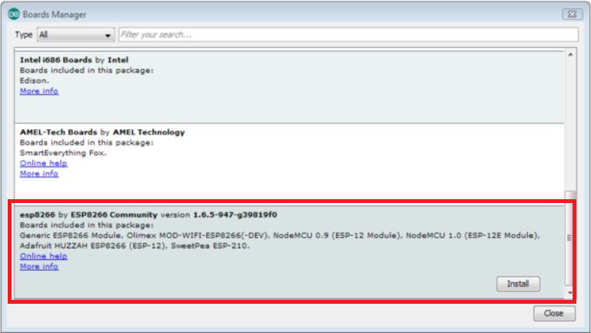
Arduino WeMos Board Development environment Setup
STEP 5
Please Move cursor down and click "esp8266 of ESP8266 Community" to install.
It may take a little time. After installation, please turn off and turn on the Aduno IDE.

Slide 7
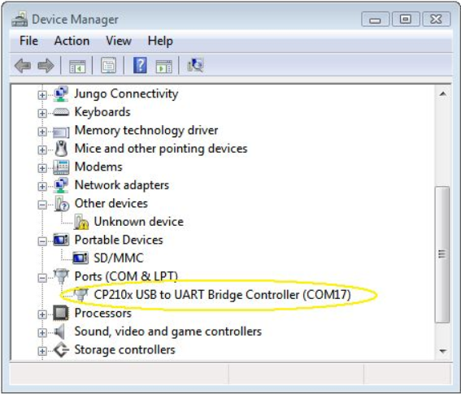
Arduino WeMos Board Development environment Setup
STEP 6
You can check in Device Manager to see if it is installed properly.

Slide 8
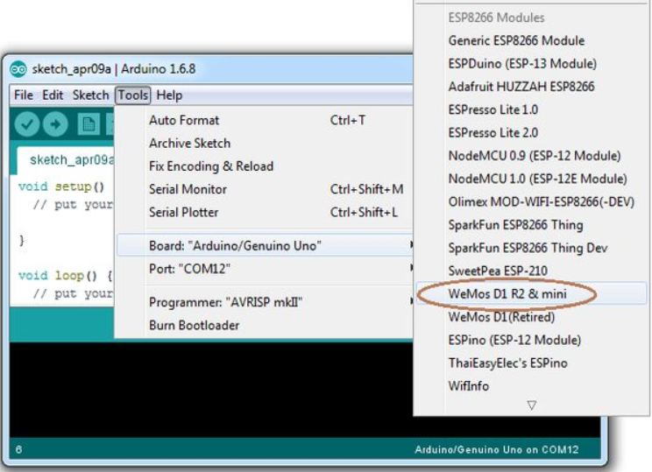
Arduino WeMos Board Development environment Setup
STEP 7
Choosing a WeMos Board
Select "Tools> Board> WeMos D1 R2 & mini".

Slide 9
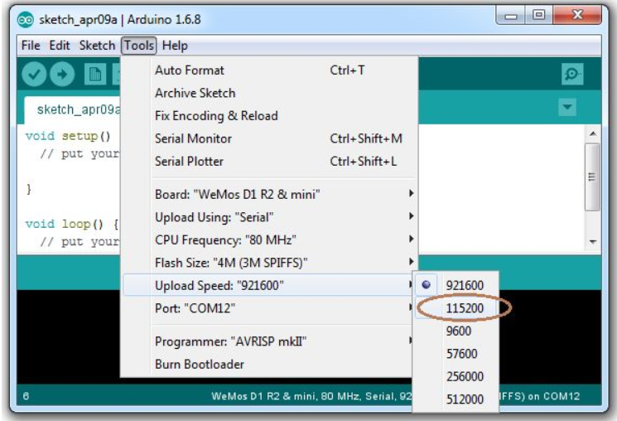
Arduino WeMos Board Development environment Setup
STEP 8
Setting the WeMos board speed
Select "Tools> Upload Speed> 115200".

